Slide 1
Embedded Systems
(Cyber-Physical Systems):
Lecture 3:
Von Neumann architecture / Harvard architecture
A system with a small instruction set—example
Instruction set design (team exercise)

Slide 2
Typical Embedded Processor Architectures
“Harvard architecture”:
--PIC processor family
“von Neumann architecture”:
--simple processor
--μP 3 processor
--MIPS processor
--NIOS II processor core (Altera “soft core” processor)
Control
Instruc.
I/O
Data
ALU
Control
I/O
Memory
Data +
Instruc.
ALU

Slide 3
Example: PIC processor family: processor is fixed, developer programs it
Reference: http://en.wikipedia.org/wiki/PIC_microcontroller
PIC: peripheral interface controller
Originally (~1975) for offloading I/O functions from a CPU
Harvard architecture: data and instructions (“code”) are stored separately—thus a data item and an instruction do not need to be the same length
Newer versions have a stack
One accumulator (referred to as W), but memory is usually referred to as a “register file”
Some versions allow a type of indirect addressing
Usually referred to as a RISC machine; may have up to 70 instructions
May be able to access external memory (newer versions)
Many development tools & languages available
Data
“Code”
(Instructions)

Slide 4
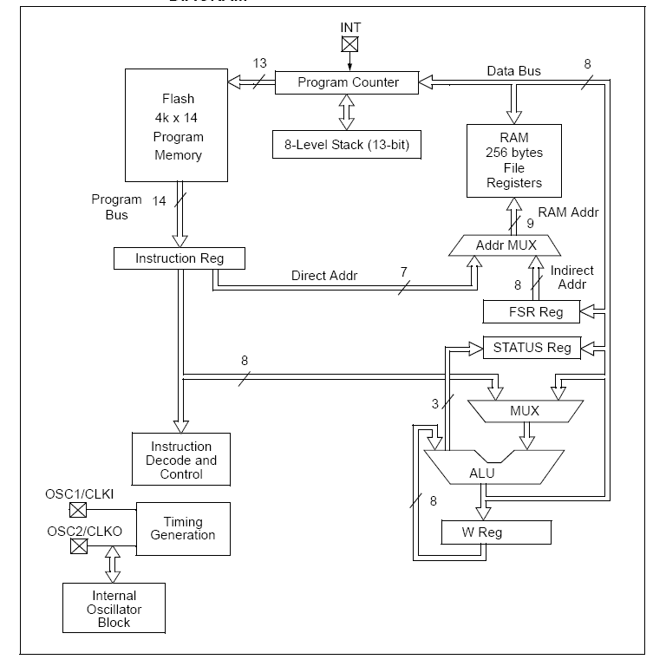
Simplified View of the Mid-Range PIC Architecture
PIC is designed with separate program and data memories.
Program flow is controlled by a program counter (PC)
Instructions are fetched into the Instruction Register (IR) for instruction decoding.
A stack is used to accommodate subroutines.
Direct and Indirect Addressing modes are supported.
Architecture allow either internal or external clock.
NOTE: What path allows you to move data from the W Reg to RAM?
NOTE: What path(s) must be used to add two numbers in RAM and store the result back into RAM?

Slide 5
PIC16F887 Control Instructions
INSTRIUCTION | DESCRIPTION |  | FLAG | CLK |  | SEE*
BTFSC f,b | Test bit b of f. Skip the following instruction if clear. | Skip if f(b) = 0 |  | 1 (2) |  | 3
BTFSS f,b | Test bit b of f. Skip the following instruction if set. | Skip if f(b) = 1 |  | 1 (2) |  | 3
DECFSZ f,d | Decrement f. Skip the following instruction if clear. | f-1 -> d skip if Z = 1 |  | 1 (2) |  | 1, 2, 3
INCFSZ f,d | Increment f. Skip the following instruction if set. | f+1 -> d skip if Z = 0 |  | 1 (2) |  | 1, 2, 3
GOTO k | Go to address | k -> PC |  | 2
CALL k | Call subroutine | PC -> TOS, k -> PC |  | 2
RETURN | Return from subroutine | TOS -> PC |  | 2
RETLW k | Return with constant in W | k -> W, TOS -> PC |  | 2
RETFIE | Return from interrupt | TOS -> PC, 1 -> GIE |  | 2
Other instructions
NOP | No operation | TOS -> PC, 1 -> GIE |  | 1
CLRWDT | Clear watchdog timer | 0 -> WDT, 1 -> TO, 1 -> PD | TO, PD | 1
SLEEP | Go into sleep mode | 0 -> WDT, 1 -> TO, 0 -> PD | TO, PD | 1
TOS:
Top OF Stack
PC: Prog Counter
GIE: Global
Interrupt
Enable
WDT: Watchdog
Timer
TO: TimeOut Bit
set to 0 if
WDT timeout
occurs
PD: PowerDown
Bit
1 if CLRWDT
0 if SLEEP
*1 When an I/O register is modified as a function of itself, the value used will be that value present on the pins themselves. *2 If the instruction is executed on the TMR register and if d=1, the prescaler will be cleared. *3 If the PC is modified or test result is logic one (1), the instruction requires two cycles (most instructions take 1 cycle, i.e., this processor is “pipelined”—see documents MCU1 & MCU2 in “additional documents” if interested)

Slide 6
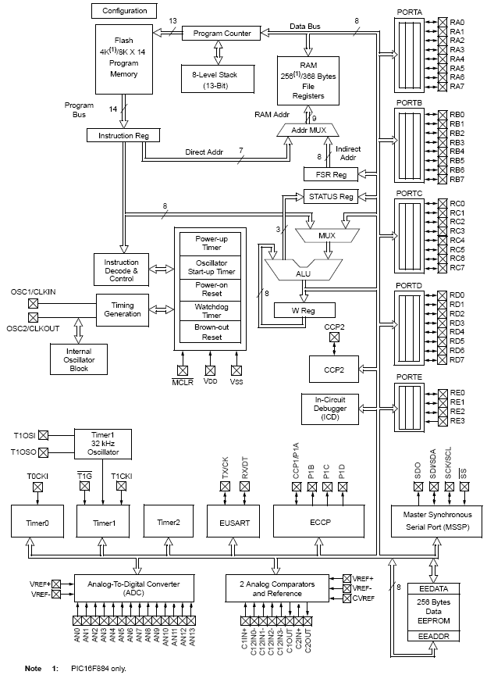
Full Block Diagram of the PIC887
Features
4- 8bits ports and 1 4-bit port
8K of program memory
368 bytes of data registers
256 bytes of EEPROM data
8 level stack
Programmable clock options
Several programmable reset controls
2 8-bit and 1 16-bit timers
14 selectable inputs to ADC
2 analog comparators
EUSART (asynchronous serial port)
MSSP (synchronous serial port)
2 Capture/Compare/PWM modules
Support for In-Circuit Debugger

Slide 7
Some sample programs:
Let I,J be integers stored in memory. Read in a third integer X. If X >= 0, output I +J; else output I-J
Compute the sum of n numbers stored in an array in memory
Call a swap subroutine (SWAP(X,Y) that exchanges contents of mem locations X and Y). Remember that you need to return from the routine.
(also, need logical ops: In-put A,B. Output A xor B.)
“Tiny Processor” Minimal hardware resources, high degree of functionality
M: memory
MA: memory address register
MD: memory data register
IR: instruction register
AC: accumulator
CF: carry flag (1 bit)
IA, IB: index registers (11 bit)
PC: program counter
MA
M
***
IR
AC
CF
MD
IA
IB
PC
ABUS (16)
BBUS (16)
ALU
ALU OUTPUT
OBUS (17)
Word addressable—all words 16 bits
Instruction format:
Op code
(3)
Addr Mode (2)
00:direct
01:indirect:
10: IA; 11:IB
Address
(11)
Functionality:
2's complement add, subtract, multiply, and divide, and, or, not
2. jumps (conditional and unconditional),
3. simple subroutine call and return
4. Interrupts
5. I/O
What should instructions be?
(Hint: expanding opcode)
“Our” processor—with questions to answer by Monday

Slide 8
Some specific questions:
OP CODE DEFINITIONS: 000_______ 100_______ 111 (give ALL instruc): 001_______ 101_______
010_______ 110_______
011_______
Can the listed programs be implemented? Explain.
Functions inside ALU (give ALL):

Slide 9
4. Control signals:
example: allow IR or AC on ABUS
5. How will “Jump to subroutine” be handled? Where will return address be stored?
How will interrupts be handled?
How will I/O be handled?
What is memory size? Explain.

Slide 10
“HINTS” (from announcement):
1. Look at the schematic of the processor and figure out where data and result need to be for a 1-operand instruction such as NOT and also for a 2-operand instruction such as AND.
2. Define the logical instructions AND, OR, NOT (hint: remember digital design, do you really need 3 separate instructions?)
3. Review 2's complement arithmetic, how do you subtract?
4. Define addition and subtraction--do you really need two different 2-operand instructions?
5. Define multiplication and division--how would you do these operations if you only knew how to add and subtract? What other 1-operand instructions would you need?
6. What instructions do you need to do LOAD and STORE (AC <--> MEM)?
7. What are the fundamental control structures in a program? (not subroutine call ). What instructions do you need to implement them? (As an embedded systems programmer, you are allowed to use an unconditional JUMP; you can also use the CF register cleverly).
8. How does a subroutine call differ from a BRANCH? What clever way can you think of to store the needed return address? Remember that you hve 4 ADDRESSING MODES, Direct, Indirect, and Indexed by either reg A or reg B.
9. Once you have figured all this out, you should be able to answer the remaining questions in the assignment.

